Slide 1
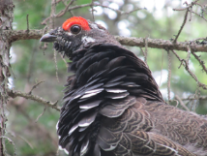

Spruce Grouse Habitat Ecology in Maine’s Commercially Managed Acadian Forest
Stephen W. Dunham
Daniel J. Harrison
Erik J. Blomberg
Notes:
Welcome and thank you all for coming today! First I would like to thank my committee starting with Dan Harrison my advisor, Erik Blomberg, Brian Olsen from SBE and Dan McAuley from USGS Patuxent Wildlife Research Center

Slide 2
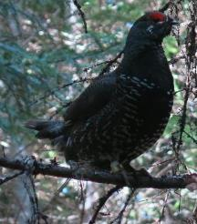
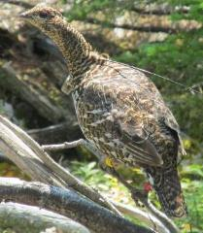
Spruce Grouse Range
Williamson, S.J., D. Keppie, R. Davison, D. Budeau, S.
Carrière, D. Rabe and M. Schroeder. 2008. Spruce Grouse
Continental Conservation Plan. Association of Fish and
Wildlife Agencies. Washington, DC. 60 pages.
Notes:
Because of this reliance on conifer tree species, spruce grouse are found mainly in the boreal forest that stretches across north America between the artic tundra and temperate deciduous forest zones. They are abundant across Canada and Alaska but the contiguous US are found only in the high-elevation conifer forests of the west and the mixed transitional forests of the mid-west and northeastern United states.

Slide 3
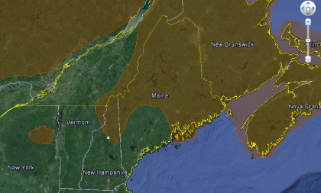
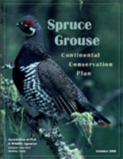
Spruce Grouse in the Region
Williamson, S.J., D. Keppie, R. Davison, D. Budeau, S.
Carrière, D. Rabe and M. Schroeder. 2008. Spruce Grouse
Continental Conservation Plan. Association of Fish and
Wildlife Agencies. Washington, DC. 60 pages.
Notes:
The southeast extent of spruce grouse range intersects the Acadian Forest of the Northeast US and maritime provinces of Canada. This forest is the transitional mixed forest between the boreal to the north and the northern hardwood forest to the south. In this region the amount of conifer dominant forest increase as you travel from the southwest to the northeast and consequntly spruce grouse abundances also increase in this direction. Spruce grouse are listed as state endangered in NY, existing only in the adirondacks, and state endagnered in VT, where they inhabit only in the northeast kingdom. In NH spruce grouse are found in the high-elevation forests of the White mountains and the forests of Coos county and are considered a species of concern, near threatened. In Maine, which has the most forest in the northeast US, and thus the most potntial habitat, spruce grouse were recently added to the species of greatest conservation need list due to a lack of information. Conversely, in both New Brunswick and Nova Scotia spruce grouse are plentiful enough to be considered a game species.

Slide 4
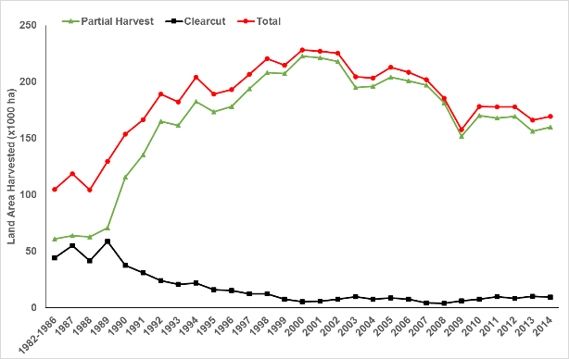
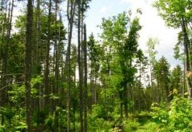
Harvest Changes 1980’s-2014
Forest Practices Act
(Maine Forest Service, Silvicultural Activities Reports)
Notes:
The forest practices act was passed in 1989 and for the first time defined clearcutting and then sought to regulate it by placing disincentives on large clearcuts. Three additional public referendums occurred in the 1990s seeking to ban clearcutting outright. This pressure had the effect of pushing companies to minimize the amount of clearcutting from about 44% before 1989 to less than 5% by 2000. However, markets stimulated by the large volume of wood coming out of the forest in the years previous prompted companies to increase the amount of partial harvest operations to produce enough wood volume to meet demand. This effectively doubled the harvest footprint. By the early 2000s.

Slide 5
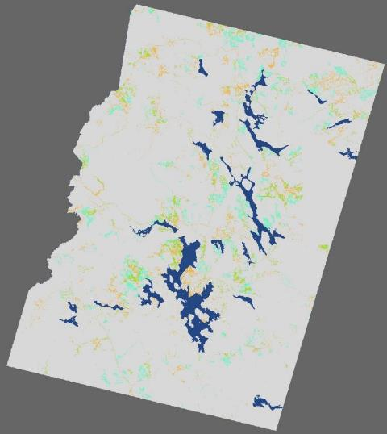
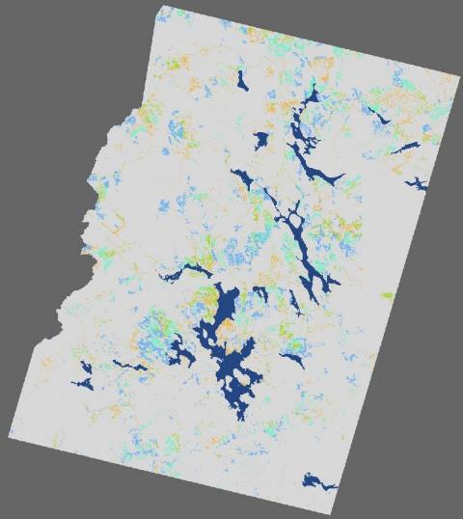
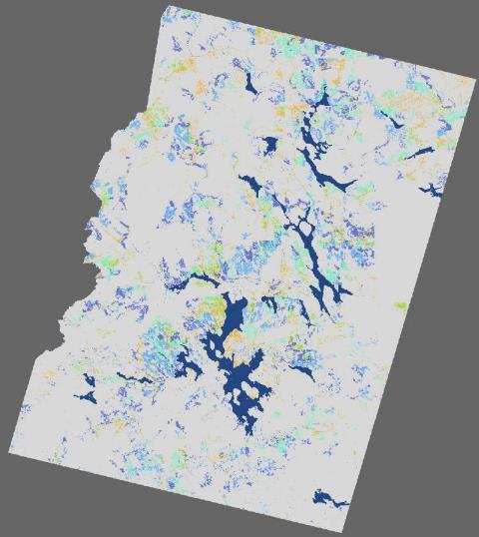
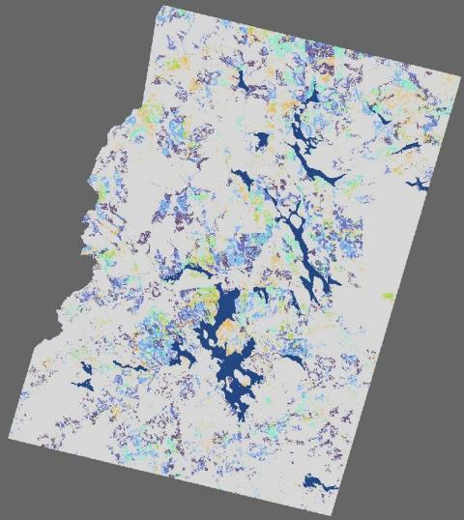
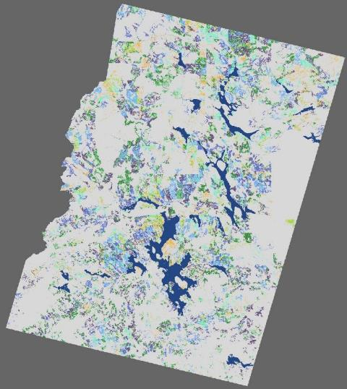
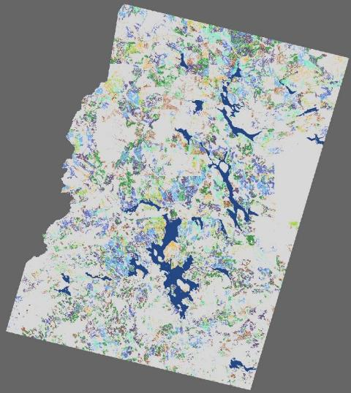
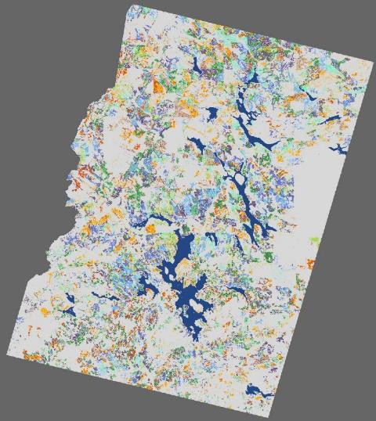
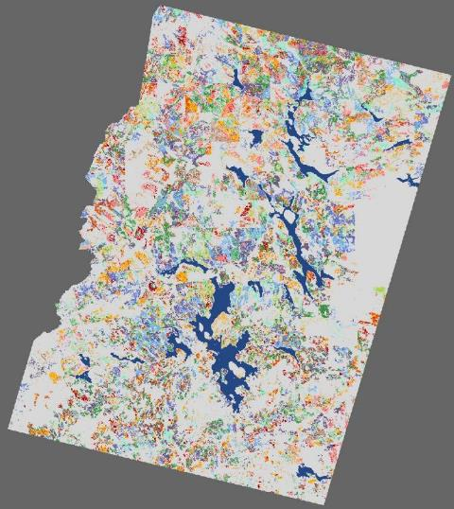
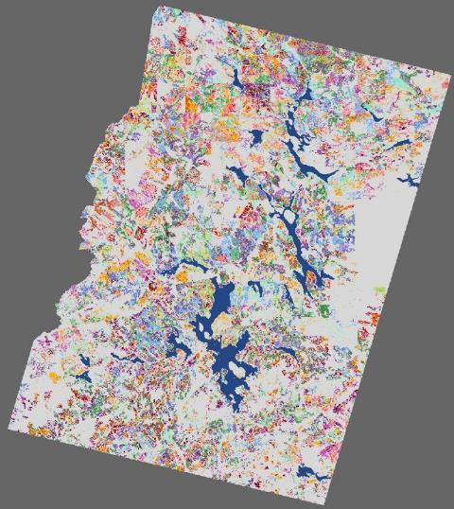
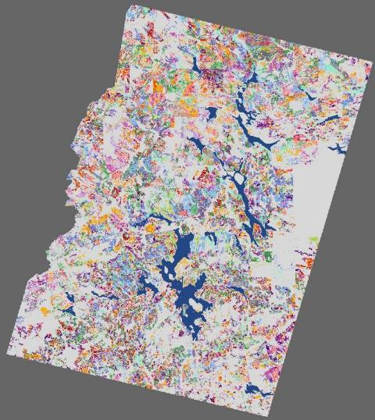
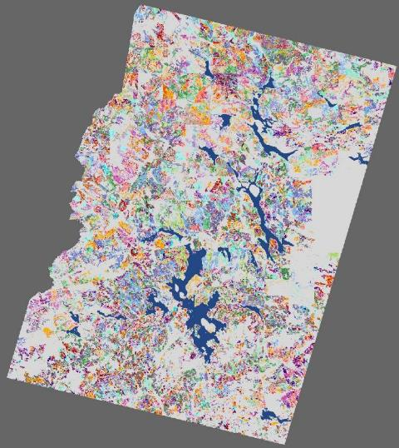
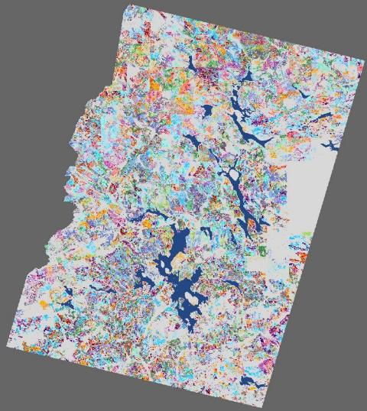
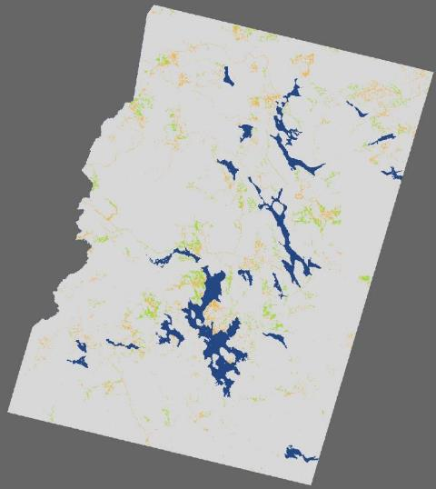
Harvest Footprint
1975
1978
1982
1985
1988
1991
1993
1995
1997
1999
2000
2001
2004
2007
Simons (2009)
Notes:
This increase can be seen in this visualization that comes from Erin Simons (now simons-legaard)’s work on lynx in Northern Maine. As you can see in 1975 the majority of this region of northen Maine was dominated by mature residual forest (white) with limited harvest operations located near major bodies of water (green). As we proceed forward in time we can see a profound cummulative increase in the harvesting footprint and a decrease in mature residual forest except within Baxter park and the debsconeg wilderness

Slide 6
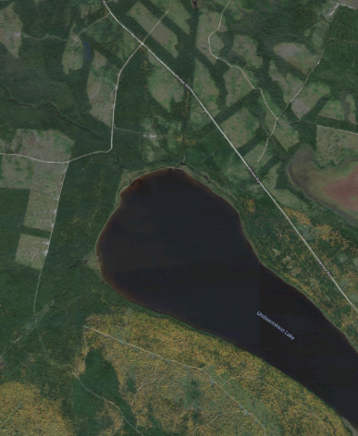
Broad-Scale Trends
Reduced extent of mature conifer forest with increasingly abundant and smaller patches
Regenerating forest patch density and edge density have increased rapidly
(Legaard et al. 2015)
Google ©2016
Notes:
Mature forests also became increasinly fragmented by the subsequent use of both partial harvests and smaller clearcuts. Additionlly, regenerating forest patches became more numerous and smaller as shown in a recent publicaiton by Kasey Legaared et al. in Plos 1.

Slide 7
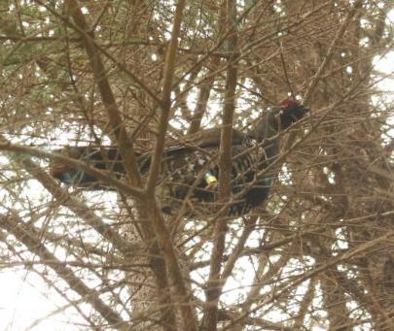
Goal
To understand how common forms of forest management influence spruce grouse breeding and brood rearing habitat in commercially managed forests
Notes:
Thus the goal of our study was to…

Slide 8
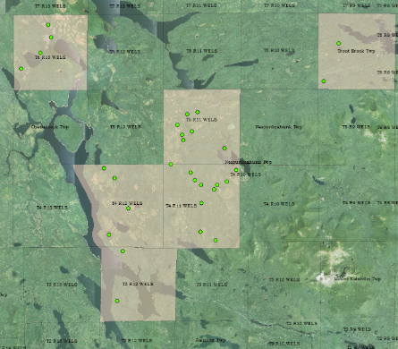
Study Area-
Notes:
To get at this goal and adress both portions of our study we located 30 forest stand within a 613 km² study area that included six townships in Piscatiquis county Maine.

Slide 9
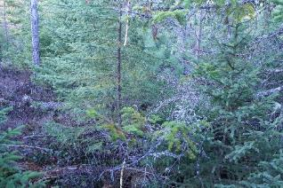
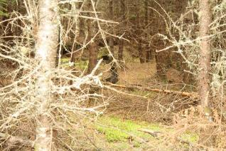
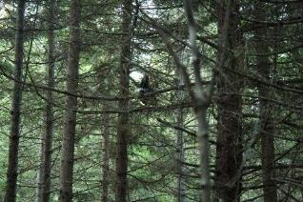
Stand Types
Conifer Regeneration
  n=10,
  Clearcut 1972-1994 and sprayed 1982-2005
Pre-commercial Thinning
  n=10
  Clearcut 1974-1983, sprayed 1982-1988, and thinned between 1994-1999
Notes:
These 30 stands were broken down into four stand types including conifer regeneration stands that were clearcut between 18 and 40 years prior to 2012 and aerially sprayed with herbicide (all but one stand that was too wet) between 7 and 30 years prior to 2012. Pre-commercially thinned stands were clearcut betweeen 29 and 38 year prior to 2012, sprayed with herbicide 24-30 years prior to 2012, and were then manually thinned by crews with brush saws to create about 8’ of space between remaiing trees.

Slide 10
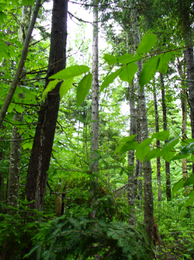
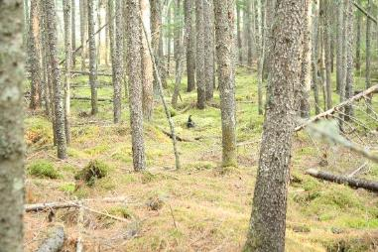
Stand Types
Partial Harvest Stands
  n=4
  Selection harvest 1992-1995
Mature
  n=6
  No record of harvest (1970-present)
  Average mature stands >80 years old (Simons-Legaard et al. 2013)
Notes:
Partial harvest stands were selection harvests cut by either saw crews or single grip processor machines that left one dominant tree every 4.6m. This resulted in a more complex age structure within the stand and a shift in composition from conifer dominant to mixed forest condtion. Mature conifer stands had no record of harvest after 1970 (when reliable records began being saved) but we know from previous work (Erin Simons legaard) that the average age of residual conifer stands in the region was greater than 80 years.

Slide 11
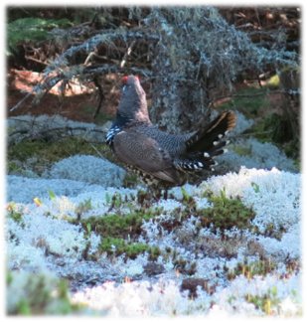
Breeding Male Occupancy and Abundance
How does the maturity, structure, and composition of the commercial forest affect male spruce grouse occupancy and abundance during the breeding season?
Notes:
The objective of chapter 1 was to understand the patch occupancy and abundance of male spruce grouse in commercially managed forests during the breeding season. Because of the male display and territoriality during this period, detection is more likely and it is doubtful that grouse would occupy a stand that did not contain females.

Slide 12
Survey Methods
Call Back Surveys
  May-June
  2012, 2013, 2014
Notes:
In order to locate males we used call-back surveys where we played a clip of a female territorial call, known as a cantus call, which enticed males to respond with their flutter-flight display. These surveys were timed for the breeding season (may-june) and we surveyed each stand three times within a year.

Slide 13
Vegetation Measurements
Maturity in Yellow, Structure in Green, Composition in Black, Nuisance in Blue
Tree Diameter
Tree Height
Basal Area of Trees
Pruning Height
Canopy Cover
Canopy Cover Variation
Total Saplings
Conifer Tree Density
Deciduous Tree Density
Total Basal Area
Stem Cover Units
Notes:
In order to address our question we measured vegetation covariates at 20 random points within the surveyed stand and focused on 11 measures that addressed stand maturity, structure, composition, and our ability to detect grouse.

Slide 14

Data Analysis
Occupancy Models
  Presence/Absence
Abundance Models
  Estimated Abundance
Priciple Components Analysis
  Visualize Stand Differences
Notes:
Finally, we performed a principle component analysis with all the retained variables to enhance our understanding and visualize the combined effect of all variables across our stands. We transformed the variables with a yeo-johnson transformation and then z standardized these values. We used varimax rotation to group and interpret the loadings of each component. Finally we created gaussian ellipses around our occupied and unoccupied stands in the first PCA and then around the various stand types in our second PCA.

Slide 15
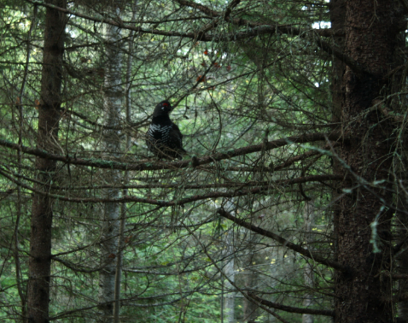
Results
Surveys
  73 Surveys across 30 stands
Detections
  19 of 30 total stands
Notes:
In all we completed 219 surveys across our 30 stands. Explain numbers. We detected grouse in 19 stands and counted between 1 and 5 individual responding males in our occupied stands. We did not included any observations of females or non-displaying males although we did observe both.

Slide 16
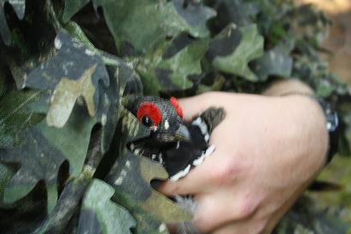
Results- Drivers of Occupancy and Abundance
Composition
Deciduous Tree Density²
Maturity
Tree Diameter²
Structure
Pruning Height
Notes:
Our abundance models also had seven models outperforming the null with six representing covariates and the same group model as the occupancy model. These results are similar to the occupancy resutls except we see a quadratic effect of trees and instead of canopy cover variation and total saplings we see an effect of basal area of trees and conifer tree density (both quadratic).

Slide 17
Occupancy Results
(Error bars represent standard error)
p remained ~0.60 (SE=0.07) across all surveys
Notes:
The group models estimated a 76.8% probabiliyt of occupancy for our early-mid successional stands and a 37.4% probabiliyt of occupancy for our mature stands (our selection stands were fixed to zero due to never observing individuals in these stands). The error bars on the estimates do overlap, but there does appear to be a trend between the two groups.

Slide 18
Abundance Results
(Error bars represent standard error)
r was 0.24 (SE=0.06) across all three years
Notes:
Our abundance models, which could compare numbers of grouse rather than just presence absence, found a significant difference between our early-mid successonal stand and our mature stands with 2.7 individuals estimated to be in the average younger stand and 0.7 individuals estimated to be in the older stands.

Slide 19
Stand Type Vegetation Profile
Deciduous Composition
Stand Maturity
Notes:
When we shift the groupings to stand types, we see that our highly occupied stands were the younger stands (regen in blue and pct in green) cluster to the left and middle and our older, less occupied stands (mature in red) were clustered to the right). Our selection stands, although also grouped with mid-successional stands, had no detections of grouse and are found way down on conifer composition axis.

Slide 20
Deciduous Tree Density
Peak abundance at 140 trees/ha
Notes:
The next few slides will show effects of the top four covariates from both models. Each graph has either probability of occupancy or estimated abunance on the y, and the covariate values on the x axis. For deciduous tree density we see negative quadratic effect with an optimum density of 140-156 trees/ha which is fairly sparse. This density is consistent with gaps in our conifer dominated stands such as skid trails, copmacted soils, etc. where deciduous trees were able to take root and out-compete confier trees. These gaps were key for males to display in.

Slide 21
Tree Diameter
Peak abundance at
12.2 cm DBH
Notes:
Both models also predicted negative effects of tree diameter on both occupancy and abundance. This shows that males are more likely to be found in younger stands.

Slide 22
Pruning Height
Abundance > 1
below 3.1 m

Slide 23
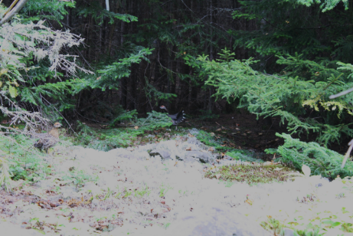
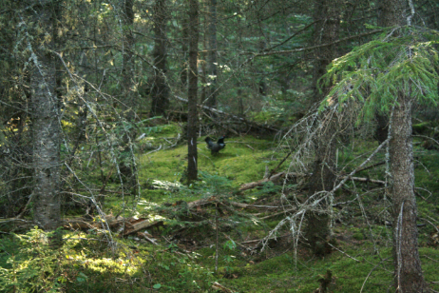
“Ideal” Occupied Stand
Notes:
Two examples of “ideal” stans are seen here. The first shows two grouse around an opening in an otherwise uniform conifer stand. The second shows a patchier mid-successional stand.

Slide 24
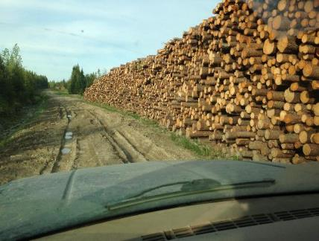
Summary
High detection (60%) across surveys
Occupancy and abundance highest in early-mid successional stands
No grouse detected in partial harvests
Notes:
Ontario estimates 10-22 birds/km^2 with 50 birds/km^2

Slide 25
Management Implications
Intensely managed stands highly occupied
Variation within a stand is good
Retention of coniferous regeneration is essential

Slide 26
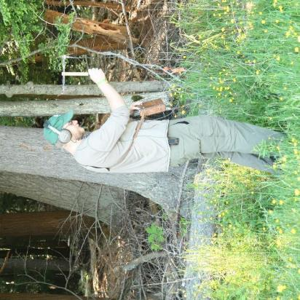
Female Habitat Selection
What attributes of maturity, cover, and patchiness, do female spruce grouse select for at sites within their home ranges?
How large are female home ranges during this period?
Notes:
The objective of our second chapter was to capture the habitat selection of female spruce grouse during the brood rearing season to understand what females select for within their home ranges when raising broods.

Slide 27
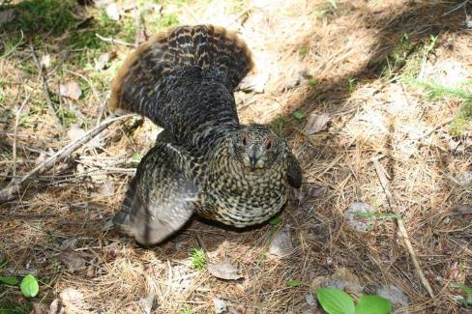
Survey Methods
Chick Distress Surveys
  June-July
  2012, 2013, 2014
Notes:
Again we used call back surveys. However, this time we used a chick distress call and performed surveys durign june and july (after fledging). We also increased the number of points within the stands to 28 with 7 survey points on 4 transects. All points were at least 60m apart and 70 m from the edge so our survey area was the same as our occupancy surveys. We hoped for female responses like the one pictured here…

Slide 28
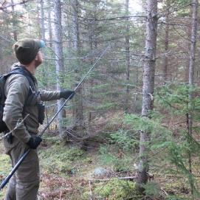
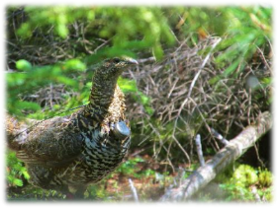
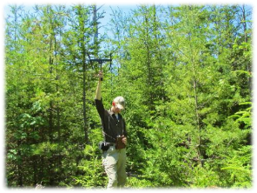
Capture and Telemetry
Captured responding grouse with a “noose-pole”
Attached a radio transmitter
Located ≥ 4 times/week
Notes:
All responding females were captured (if possible) and if > 400 g they were fitted with a 12g ATS transmitter and released.

Slide 29
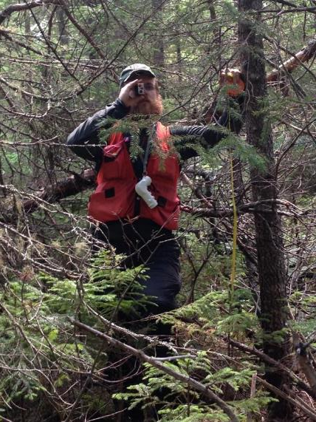
Methods: Vegetation
Maturity in Yellow, Cover in green,
Patchiness in Black
Vegetation Measurements
Quadratic Mean Diameter
Total Tree Density
Basal Area of Saplings
Tree Height
Canopy Height
Pruning Height
Moss Groundcover
Lateral Cover
Percent Low Cover (7 cm-0.5 m)
Percent Mid Cover (0.5 -1.5 m)
Percent Overhead Cover (>1.5 m)
Total Basal Area
Canopy Closure
Canopy Closure Variation
Lateral Cover Variation
Notes:
At both the used and available points we measured 15 variables we believed to be biologically meaninful to spruce grouse. These are broken down into three categories, this time describing maturity, cover, and patchiness.

Slide 30
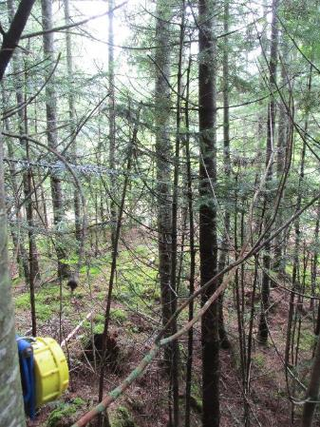
Use vs. Availability
Use
  15 sites/home range
Availability
  10 plots/focal stand/bird
Notes:
We defined used locations as 15 randomly selected relocation sites and availability as 10 of the plots surveyed within the surveyed stand the bird was caught in. We used only 10 that were closest to the geographic mean center of the birds home range to minimize repeated measurements as multiple birds were captured within some stands.

Slide 31
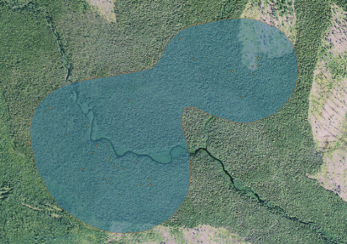
Methods: Statistics
Habitat Selection
  Resource Selection Functions
Home Range
  80% Fixed Kernels

Slide 32
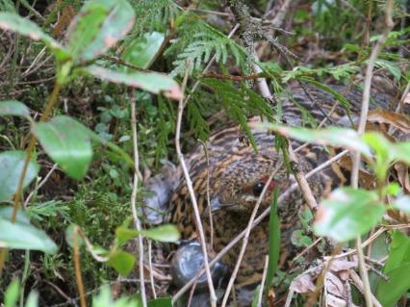
Results
39 hens captured
30 hens were included in habitat use analyses
Birds were located 919 times total
Vegetation was measured at 450 use locations and 300 available sites
Notes:
In total we captured 39 hens but only included 30 hens in our analysis. The others were either released without radios due to multiple marked females already existing within a stand, had a radio dislodge, or died too soon after release for any meaningful analyses. We made a total of 919 visual relocations during the breeding seasons and vegetation was measured at 750 total locations.

Slide 33
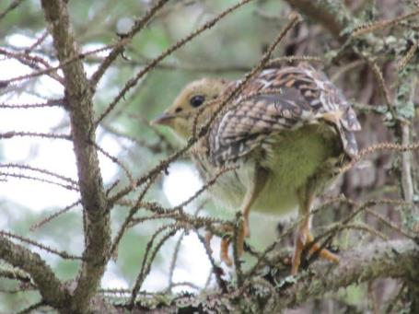
Results: Tree Use
134 locations (14.6%)
Tree Species Pattern:
  Larch = 34.3%
  Spruce = 31.3%
  Balsam Fir = 17.2%
  Unknown = 8.2%
  Snag = 7.5%
Notes:
Of the 919 locations, birds were located in trees 14.6% of the time. Only 2 birds were never seen in trees. This increased through the seasons with only 1.1 use/bird prior to aug 1 and increased to 3.3 uses / bird after 1 aug. Also, birds with broods had an average of 3.6 locations in trees while birds without broods or who lost broods early used trees 7.1 times during the summer. Larch was the most often used followed by spruce, balsam fir, unidentified species snags. We only recorded birds in pine or cedar trees once each and never in a live deciduous tree.

Slide 34
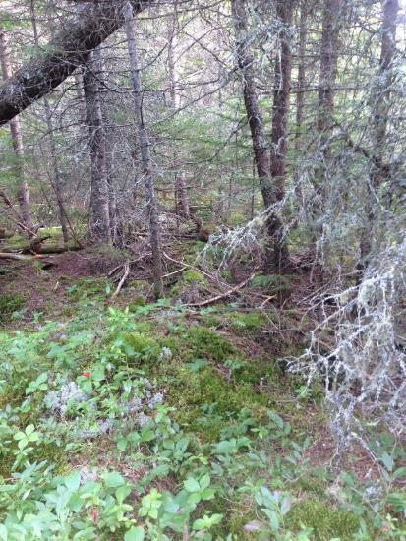
Results: Habitat Selection
Major Drivers:
  Total Tree Density²
  Pruning Height²
  Percent Low Cover
  Canopy Cover Variation²
Notes:
After the initial univariate screening we were left with these three global models describing maturity, cover, and patchiness. If the quadratic term outperformed the linear term by > 2.0 AIC values it was retained.

Slide 35
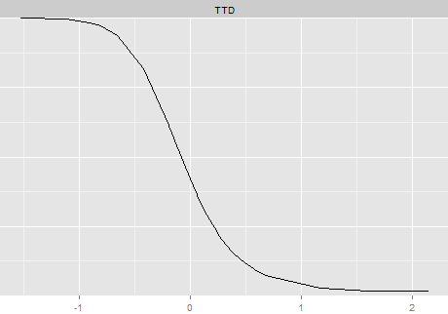
Drivers Across Models
1.00
Total Tree Density
0.75
0.5
Probability of Selection
0.25
0
590
1429
2268
3108
Total Tree Density (trees/ha)
Notes:
The next four slides will all have the same design showing the probabiliyt of selection on the y and the values of the covairate on the x. First, we had total tree density which shows that fmales are slecting for sites with low tree densities.

Slide 36
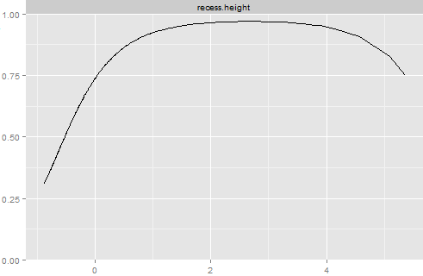
Drivers Across Models
1.00
Pruning Height
0.75
0.5
Probability of Selection
0.25
0
1.2
4.0
6.8
Pruning Height (m)
Notes:
Next we have pruning height (which is the height of the lowest limb (dead or alive) that could be reasonably assumed to hold a grouse). This is only applicable to trees not saplings, and covers a wide range of hights, but you can see that selection increases with height, especially at heights above about half a meter.

Slide 37
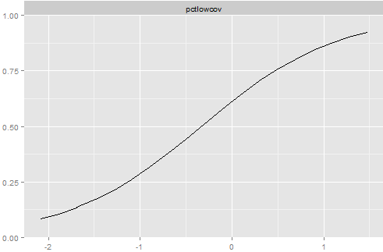
Drivers Across Models
1.00
Low Cover (7 cm-0.5 m)
0.75
0.5
Probability of Selection
0.25
0
0
30
60
90
Low Cover (%)
Notes:
Low cover, or the amount of vegetation between 7cm and 0.5m is positively associated with selection

Slide 38
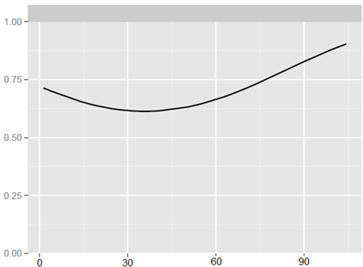
Drivers Across Models
Lateral Cover Variation
1.00
0.75
0.5
Probability of Selection
0.25
0
0
30
60
90
Amount of Variation
Notes:
And finally, the amount of variation in lateral cover (the amount of vegeation that could conceal a grouse on the ground( has a quadratic relation ship with selection, but areas with very patchy lateral cover were selected for most often.

Slide 39
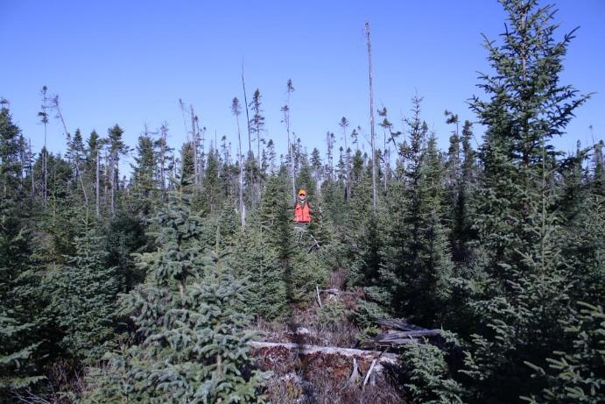
Example “Ideal” site
Notes:
Here we can see a site described by the above variables. The trees in the area > 7.6 cm dbh are sparse and have high pruning hieights. There is abundant cover near the ground, but aranged in a patchy manner. The abundant saplings provide escape cover from both avian and terrestrial predators.

Slide 40

Results: Home Range
27 Females
80% Fixed Kernel
Average: 37.7 ha (93.2 acres)
Range: 9.0 – 82.7 ha (22.2 – 204.4 acres)
Notes:
Finally, we were able to estimate home ranges for 27 of our females (3 did not have 25 locations after screening). After comparing isopleths to their estimated home range size, we chose the 80% isopleth to ensure we did not overestimate the home range size. This resulted in an average of 37.7 ha but was highly variable between individuals. Thus we calculated the 75th percentile so that we could recommend a scale of managent that would include an area suitable for ¾ of our observed grouse. Spruce grouse home ranges are highly variable across all portions of their range, Estimates from the boreal forest of Ontario estimate between 22-75 ha and the average in the adirondakcs of new york was estiamted to be about 58 ha.

Slide 41
Summary
Habitat Selection
Home Range
Low tree densities (< 1100 trees/ha)
A wide range of pruning heights (1.3-8.0 m)
Abundant low vegetation
(> 73%)
Most females use areas ≤ 55 hectares
Nearly ½ of a females home range occurred in a single stand
Notes:
In summary, spruce grouse females are seeking areas with low tree densities, generally eleveated pruning heights and abundant low vegation. These features should be within an area of about 55 ha to meet the nees of most grouse.

Slide 42
Management Implications
Selection for immature sites with abundant understory vegetation
Both intensly managed stands and coniferous wetlands were common used
Winter habitat may look very different

Slide 43
Chapter 1 & 2 Takeaways
Spruce grouse prefer early-mid successional forest
Juxtaposition of breeding and brood rearing habitat should be considered
Retention and promotion of conifer regeneration is essential

Slide 44
Future Considerations
Climate Change
Post Harvest Composition
Future Harvest Practices/Priorities

Slide 45





Acknowledgements
Funding:
Maine Agricultural & Forest Experiment Station
Cooperative Forest Research Unit
Maine Audubon (IBERA)
Landowners:
Baxter State Park
Katahdin Forest Management LLC (Acadian Timber Corporation)
Field Techs:
Mitch Jackman
Scott Parkhill
Rebecca Fontes
Cory Dunning

